Slide 1
Normalizing Flows: From NICE, RealNVP to GLOW
Krzysztof Kolasiński, 11.10.2018

Slide 2
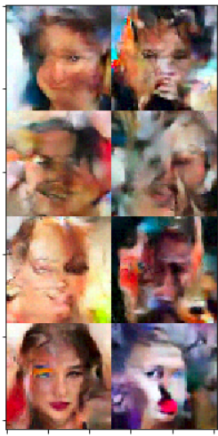
Content
Part 1. Introduction
Motivations for probabilistic models
Normalizing flows reminder
Part 2. Research papers study
NICE, RealNVP, Glow
Artflow

Slide 3
Introduction and motivations for Normalizing Flows

Slide 4
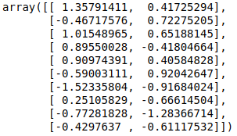
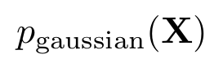
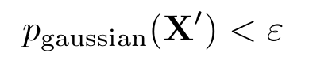
Motivation: The problem of density estimation
Consider following problem:
we observe some data X which are sample from some distribution p(X)
we want to tell what is p(X’) where X’ is some new data.
Example: anomaly detection
The simplest classical approach for this problem would be:
Take the data
Fit e.g. multivariate gaussian
Find anomalies:

Slide 5
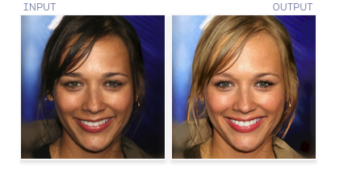
Motivation: The problem of sampling
Consider following problem:
we observe some data X which are sample from some distribution p(X)
we want to generate new data point X’ according to p(X’)
Example: dataset augmentation, latent space manipulation, generating new samples
The current state of the art approach for this problem would be to take some deep generative neural network e.g. Glow:
Example from: https://blog.openai.com/glow/

Slide 6
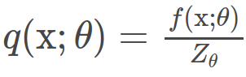
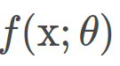
Motivation: probabilistic modeling
Probabilistic models have nice theoretical interpretation
However they are usually hard to train or they have intractable normalizing constants
Typical probabilistic model is specified as some function
where:
is some positive function parameterized with theta, usually neural network
Z is normalization constant, contains sum of f(x) over all possible configurations of x
Unfortunately:
in many cases Z is intractable, inference is impossible or require approximations
sampling may be hard, so we cannot generate samples easily
Normalizing Flows: try to overcome this problem by introducing continuous transformation of probability density which allows for tracking the change in the density p(x)

Slide 7
A brief introduction to Normalizing Flows

Slide 8
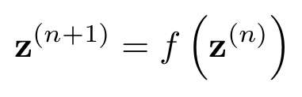
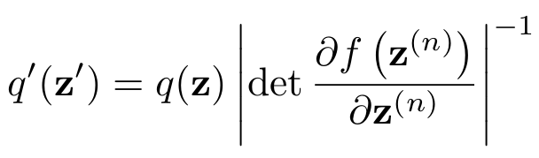
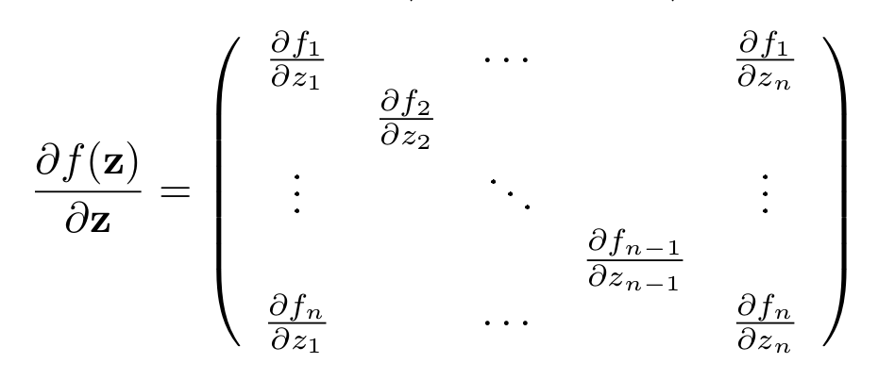
Normalizing flows - generalization
Let z be a random vector with probability density function q(z) and f(z) is an invertible function.
Transformation of the random variable leads to the following change in the probability density:
det = determinant
jacobian matrix

Slide 9
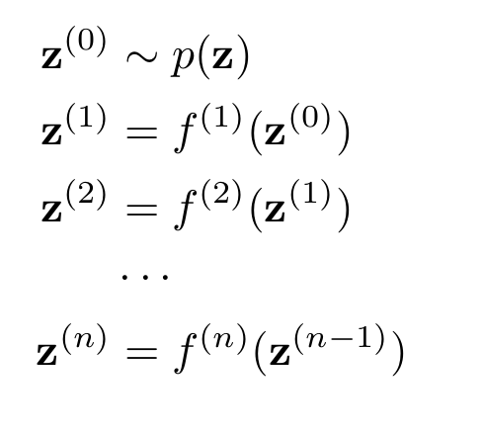
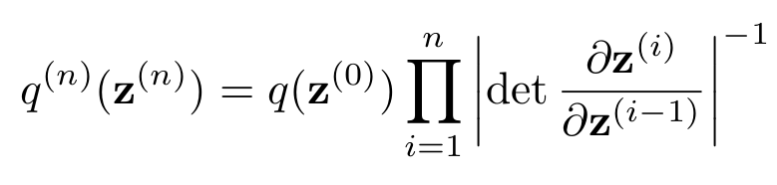
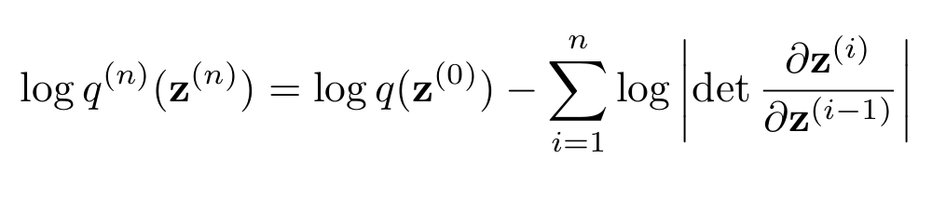
Normalizing flows - generalization
Stacking multiple mappings leads to final expression for the normalizing flow - a chain rule
density of the sampled point
Note, that in practice due to the numerical errors it is more stable to work with logarithms

Slide 10
Normalizing flows - technical details
Combining multiple transformations yields in:
In most cases when people implement NFs they take into account following rules:
use log densities, since this is more stable numerically
use f such that we can compute determinant easily: diagonal or triangular matrix for which determinant can be easily computed analytically, or other not investigated options ???
use f such that computation of f(x) is easy: efficient sampling
use f such that computation of f⁻¹(y) is easy: efficient estimation of log-likelihood
use f such that we can compute derivative of it: can be used with gradient descent
use f such that computation is stable numerically
use f such that it has high expressive power usually some non linear function
Note: Various methods have been developed, but usually only part of these conditions are satisfied.

Slide 11
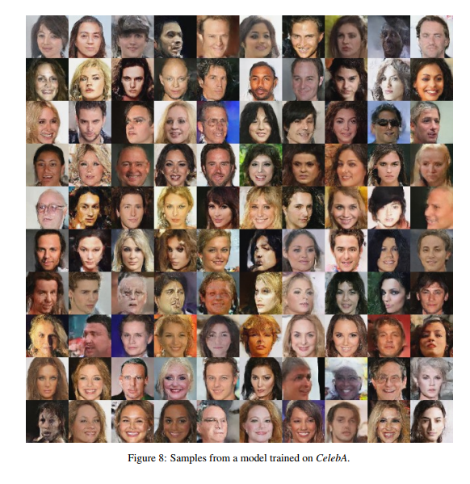
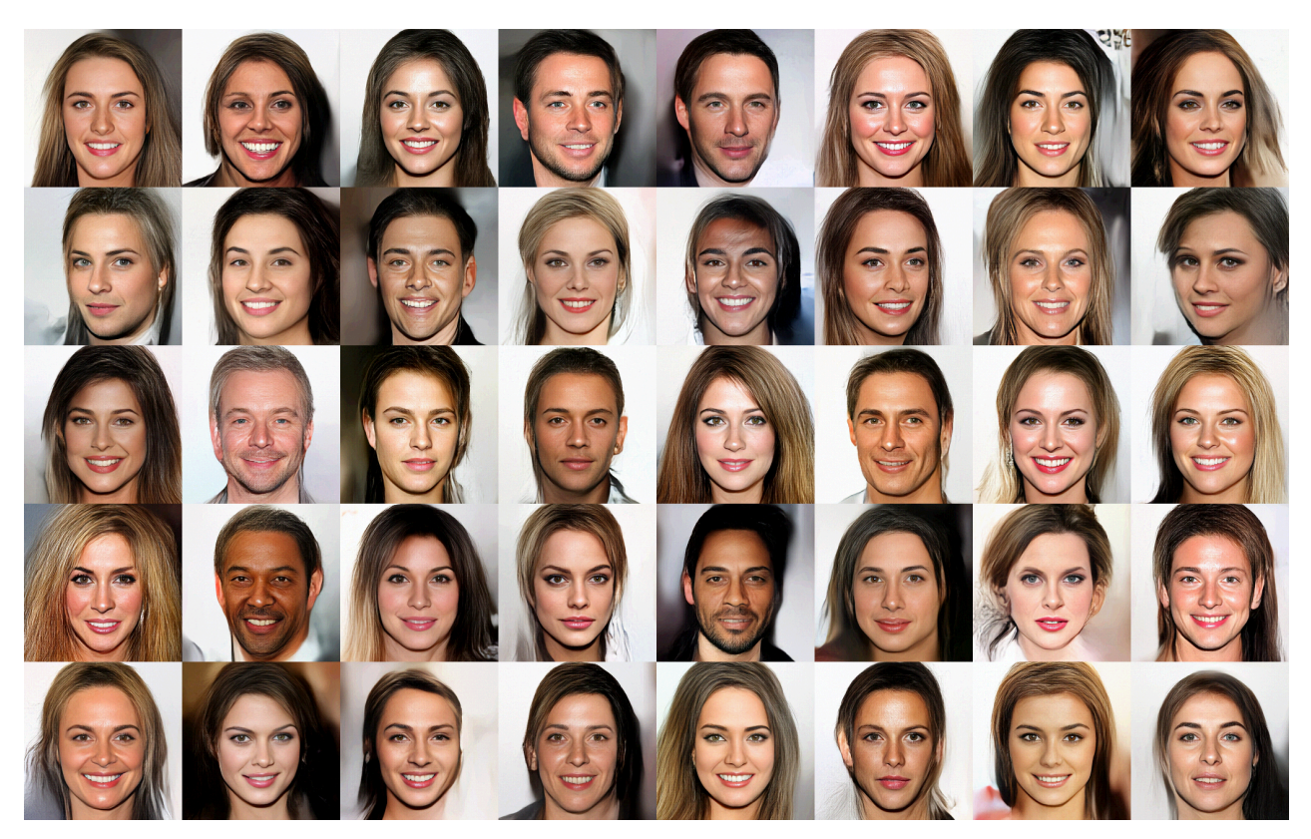
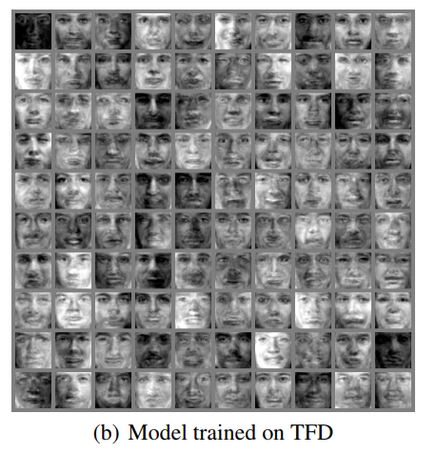
The plan
Glow
RealNVP
NICE

Slide 12
Case study: NICE 2015

Slide 13
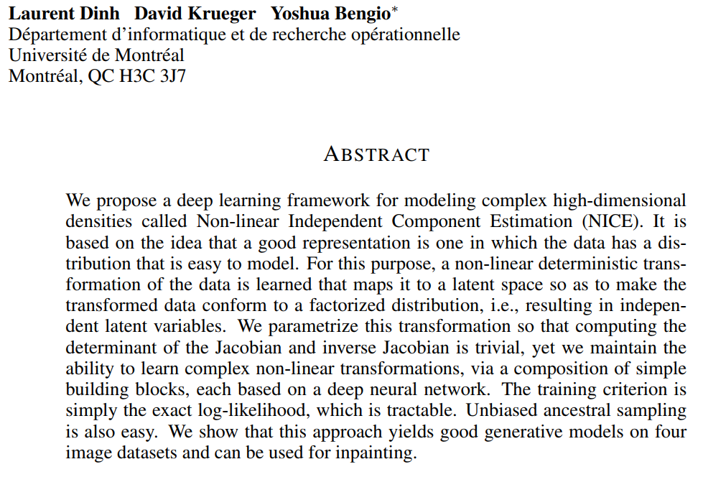
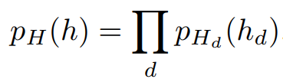
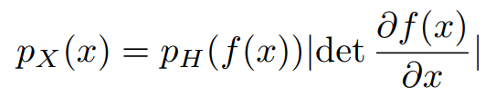
NICE: Non-linear Independent Components Estimation
probabilistic model

Slide 14
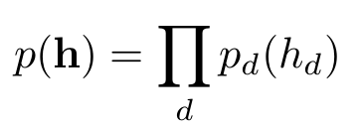
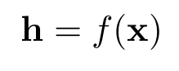
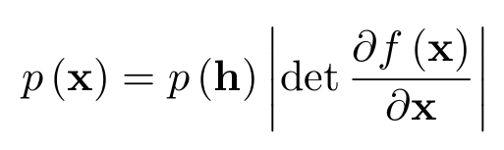
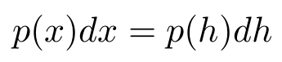
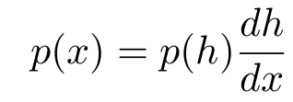
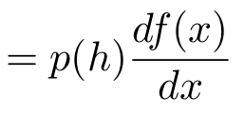
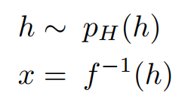
NICE: Non-linear Independent Components Estimation
Key concepts:
Let x be some high dimensional vector, and f(x) map it into new space such the resulting distribution factorizes, i.e. the components of h are independent
f - is an invertible and continuous function (bijection), x and h are vectors of the same dimensionality
The change of variables gives us:
Simple 1D “derivation”:
Sampling is trivial:

Slide 15
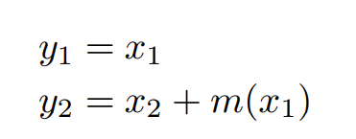
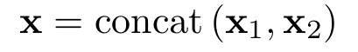
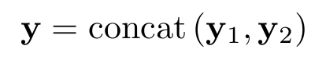
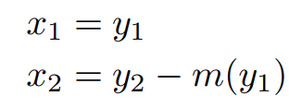
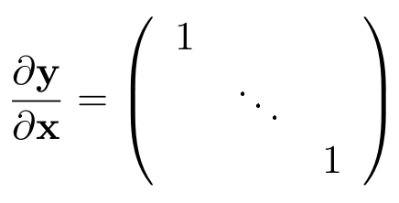
NICE: Non-linear Independent Components Estimation
Key novelty:
f with “easy determinant of the Jacobian” and “easy inverse”
Forward pass: y=f(x) and x (D dimensional vector) is split into two blocks (x1, x2)
m(x) is any function e.g. a neural network, which maps d-dimensional vector into D-d vector
Inverse:
Forward/inverse transformation Jacobian is triangular matrix with ones on the diagonal - a volume preserving transformation
dy₂
dx₁

Slide 16
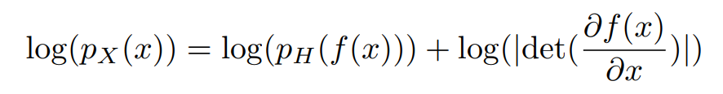
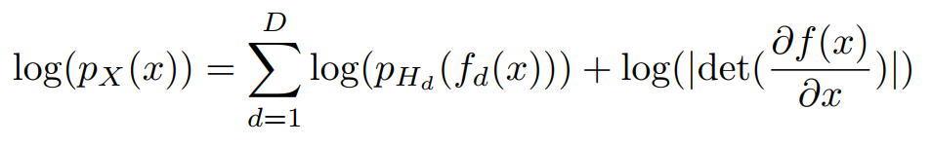
NICE: Non-linear Independent Components Estimation
Objective: maximum likelihood
The probability of observing data is:
We want to maximize logp(x) - remember this minimizes KL divergence between model distribution and data distribution:
prior distribution
zero for volume preserving operations
If prior factorizes we have:

Slide 17
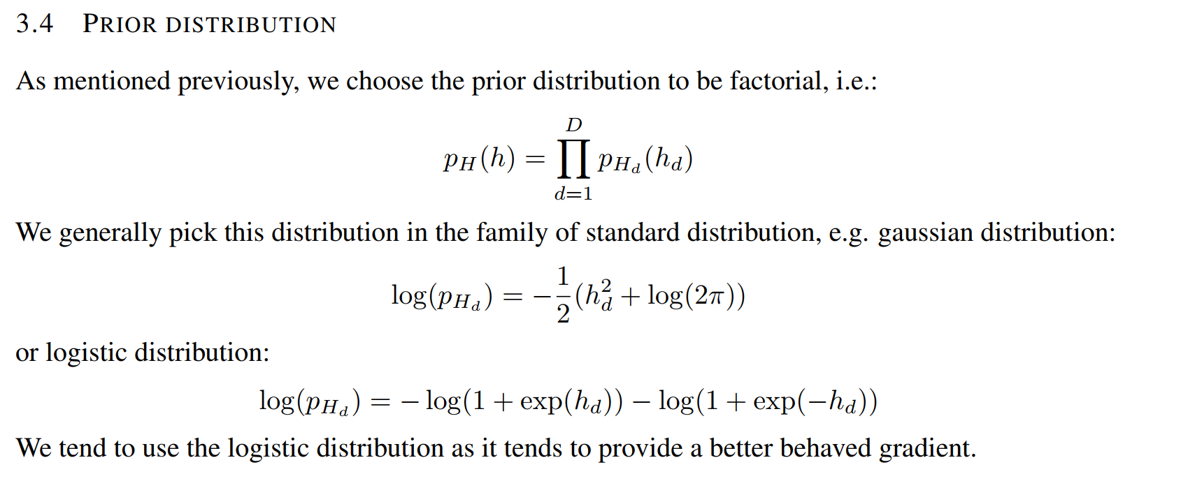
NICE: Non-linear Independent Components Estimation
Prior distribution:
Final objective is

Slide 18
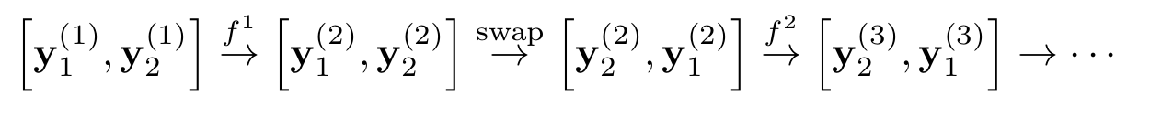
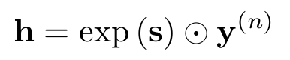
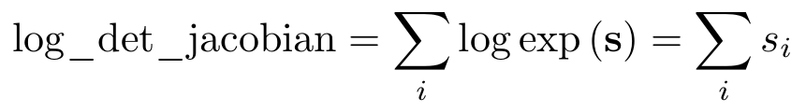
NICE: Non-linear Independent Components Estimation
Architecture
Transformation function: additive coupling layer (ACL)
m(x) - is rectified neural network (a ReLU MLP)
Combining transformations: chaining ACLs will remain some of the inputs unchanged, the authors propose to exchange the order of x1, x2 in alternating layers.
authors use 4 such steps
Rescaling output: ACL does not change volume, the authors propose to add volume changing transformation at the last layer, this allows to add weights on some dimensions

Slide 19
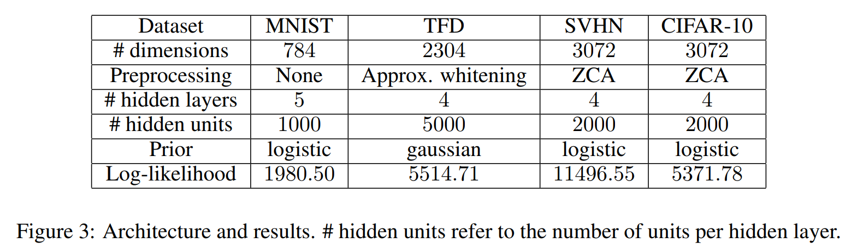
NICE: Non-linear Independent Components Estimation
Architecture
Input data preparation: MNIST add noise 1/256 and rescale to range [0, 1]

Slide 20
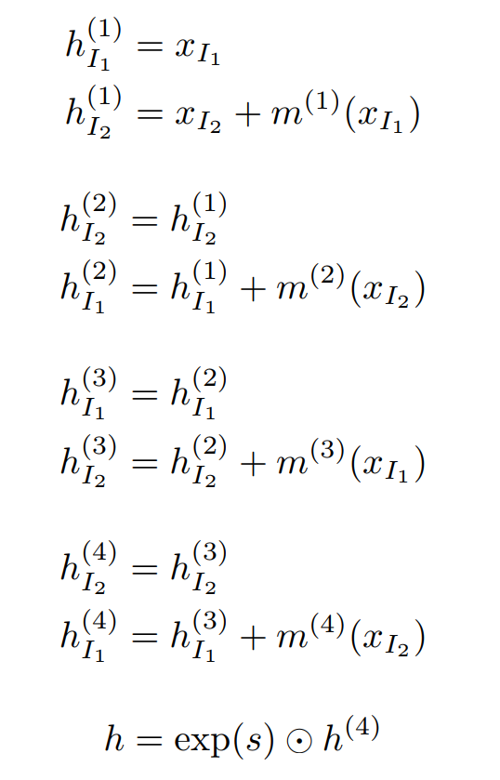
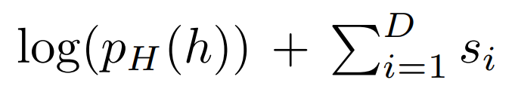
NICE: Non-linear Independent Components Estimation
Architecture - full definition (a MNIST case)
The model:
m(x) - are NNs - with 5 layers, 1000 units and ReLU
loss function (to maximize):
the prior:
optimizer: Adam
they needed 1500 epochs

Slide 21
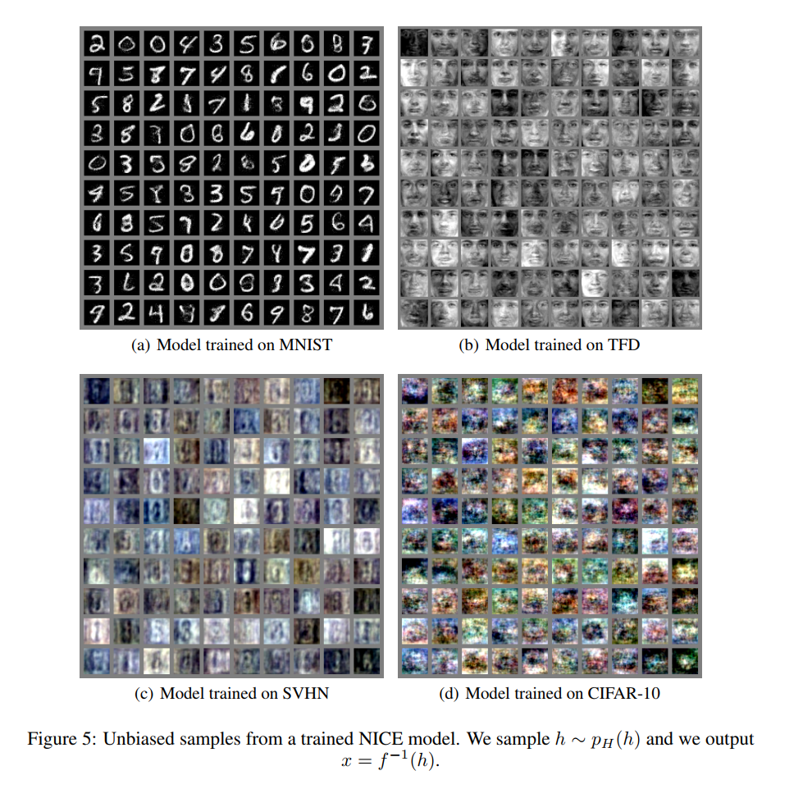
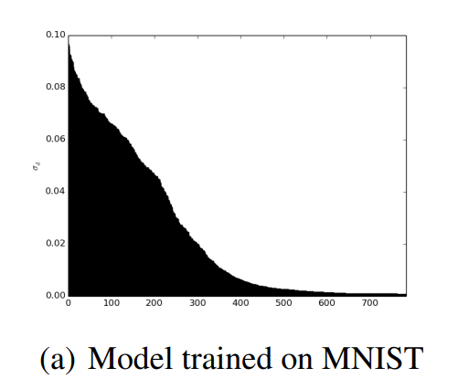
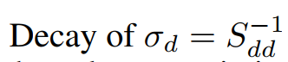
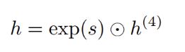
NICE: Non-linear Independent Components Estimation
Results:
Good as for the 2015

Slide 22
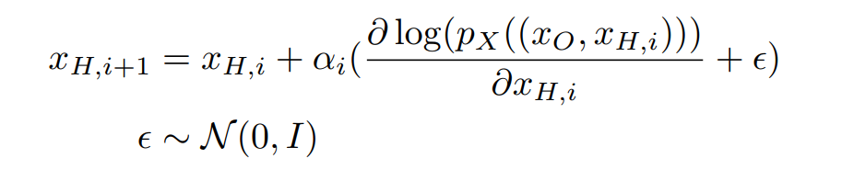
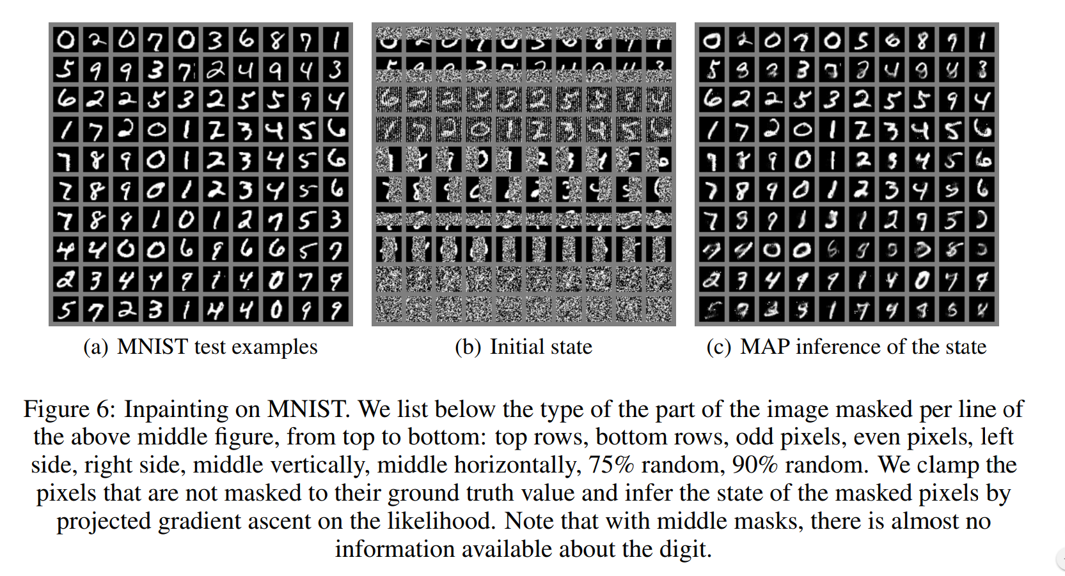
NICE: Non-linear Independent Components Estimation
Results:
Inpainting: compute optimal xH which maximizes likelihood: this can be done with gradient descent

Slide 23
Case study: Density estimation using Real NVP (2016)

Slide 24
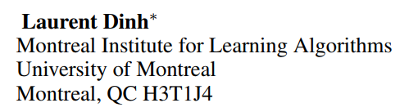
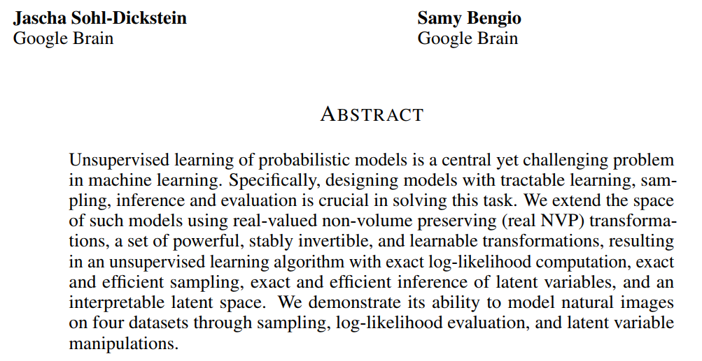
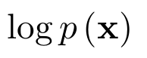
Density estimation using Real NVP
Waffling: zero content text here

Slide 25
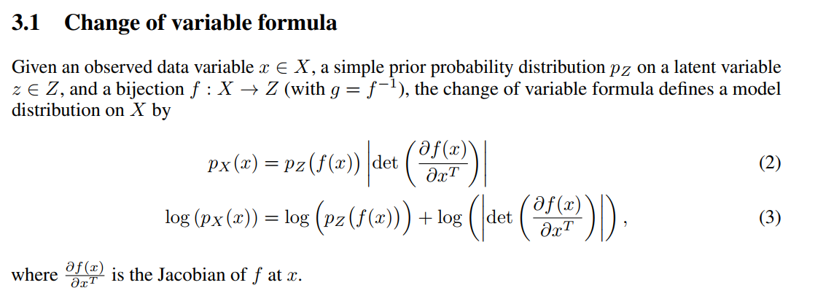
Density estimation using Real NVP
The same approach, authors use change of variables to model complex densities

Slide 26



Density estimation using Real NVP
Architecture: Coupling layers: an extension to NICE work
Coupling layer is a bijection (an invertible function) with easy to compute Jacobian: diagonal matrix
scale - some NN
(change in volume)
scale - some NN
x, y are partitioned in similar manner as in NICE
Jacobian:
where D is the size of x/y and D-d size of x₂/y₂

Slide 27

Density estimation using Real NVP
Architecture: Coupling layers: an extension to NICE work
Coupling layer is a bijection (an invertible function) with easy to compute Jacobian: diagonal matrix
scale - some NN
(change in volume)
scale - some NN
Inverse: is as easy to compute as forward flow - easy inference and sampling

Slide 28

Density estimation using Real NVP
Architecture: Coupling layers: an extension to NICE work
Forward and inverse flows

Slide 29

Density estimation using Real NVP
Architecture: Partitioning input vector
Masking convolutions: instead of explicitly partitioning x we can use binary mask
Same equation expressed in terms of binary mask
binary mask
checkerboard pattern
channel wise masking

Slide 30

Density estimation using Real NVP
Architecture: Combining multiple coupling layers
In order to enhance mixing between variables, multiple layers are stacked in alternating way

Slide 31


Density estimation using Real NVP
Architecture: multiscale architecture
Multiscale architecture is implemented by squeezing operation together with factoring out half of variables:
Squeezing operation change tensor shape from [s, s, c] to [s/2, s/2, 4c]
They factor out half of the dimensions at regular intervals:
z variables are suppose to come from Gaussian distribution
This force the model to gaussianize some of the units at different scales
This also reduces memory requirements, and we can train larger models

Slide 32




Density estimation using Real NVP
github: tensorflow/models//research/real_nvp
Architecture:
They use Batch Norm, Weight Norm with Deep Residual Networks in s and t functions
They use Batch Norm bijector after each coupling layer (see paper for more details)
They convert input image to logit space, use Adam, and L2 regularization
1. Prepare input:
3. Define cost function: -logp(x)
2. Transform input to prior density space
4. Compute gradients

Slide 33

Density estimation using Real NVP
Results: samples
dataset
sampled

Slide 34

Density estimation using Real NVP
Key advantages of RealNVP:
fast inference
fast sampling
easy to compute jacobian
Results: manifold interpolations

Slide 35


Density estimation using Real NVP
Results: funny extrapolations - generating images for higher resolutions than during training (more examples in paper)
Best faces at the edges, in my opinion this is an effect of padding

Slide 36
Case study: Glow: Generative Flow with Invertible 1x1 Convolutions (2018)

Slide 37

Glow: Generative Flow with Invertible 1x1 Convolutions
NICE
a continuous generalization for discrete rotations

Slide 38

Glow: Generative Flow with Invertible 1x1 Convolutions
Summary of likelihood-based generative models:

Slide 39

Glow: Generative Flow with Invertible 1x1 Convolutions
Summary of flow based methods

Slide 40

Glow: Generative Flow with Invertible 1x1 Convolutions
Definition of the cost function: MLE

Slide 41





Glow: Generative Flow with Invertible 1x1 Convolutions
Normalizing flows basic definitions
generative flow is defined as
Prior distribution: spherical Gaussian: , g is bijective
Inference is defined as:
Normalizing flow is defined as sequence of transformations:
The log of pdf of the model given data point is then computed as:
log-determinant of the transformation, this can be easy to compute for certain choices e.g. MADE, NICE, RealNVP

Slide 42

Glow: Generative Flow with Invertible 1x1 Convolutions
Proposed generative flow
simplified version of NICE and RealNVP works
multiscale architecture same as in RealNVP
affine coupling layer
New things:
actnorm (no Batchnorm)
data dependent initialization
invertible 1x1 conv

Slide 43

Glow: Generative Flow with Invertible 1x1 Convolutions
Proposed generative flow blocks: actnorm - activation normalization
resigned from Batch Normalization due to large variance of normalization for small batch size
they can train with batch size 1
actnorm: i,j denote spatial index of the feature map [height, width, num_channels]
initialization of s and b: initialize them such that post-activations have mean zero and unit variance, then they treat scale and bias as normal trainable parameters

Slide 44

Glow: Generative Flow with Invertible 1x1 Convolutions
Proposed generative flow blocks: invertible 1x1 convolution
use 1x1 conv instead of fixed reversing of channels, or instead of random permutation
1x1 can be considered as Dense layer which rotates and scale channels in continuous manner
the cost of computing det(W) ~O(c³) is comparable with cost of conv2d O(h*w*c²)
they initialize W as random rotation matrix, and use LU decomposition to speed up determinant computation (see paper for more details)

Slide 45

Glow: Generative Flow with Invertible 1x1 Convolutions
Proposed generative flow blocks: affine coupling layer
use 1x1 conv instead of fixed reversing of channels, or instead of random permutation
similar as in RealNVP
They use zero initialization: last layer of NN is initializer to zero, such that coupling layer is identity function at the beginning
split only along channel dimension (no checkerboard pattern), concat is a reverse operation to split
no fixed permutations - they mix channels with invertible 1x1 convolutions
NN is a shallow, 3 convolutions with 512 units: 3x3, 1x1, 3x3, the last one returns shift and logscale

Slide 46

Glow: Generative Flow with Invertible 1x1 Convolutions
Comparison of different permutation methods and affine and additive coupling
Invertible convolutions were 7% slower than simple permutation
Much better performance

Slide 47



Glow: Generative Flow with Invertible 1x1 Convolutions
More tricks: Image preprocessing -> image quantization
8 bits
2 bits
5 bits
Reducing complexity increased the quality in their case

Slide 48


Glow: Generative Flow with Invertible 1x1 Convolutions
Results:

Slide 49

Glow: Generative Flow with Invertible 1x1 Convolutions
Results:

Slide 50

Glow: Generative Flow with Invertible 1x1 Convolutions
Sampling from reduced temperature: x ~ N(0, T)
T=0
we found that sampling from a reduced-temperature model often results in higher-quality samples This may result from imperfect match between data distribution p(z) and unit gaussian (the prior).

Slide 51

Glow: Generative Flow with Invertible 1x1 Convolutions
Effect of the depth of the model
Summary:
K=32, L ~6
5 bit images
gradient checkpointing to save memory
no batchnorm, DDI
trained on cluster of 5 machines with 8 GPUs each
200M parameters and 600 layers

Slide 52
New paper which is under review (ICLR 2019 Conference)
Flow++: Improving Flow-Based Generative Models with Variational Dequantization and Architecture Design

Slide 53

My experiments
I have re-implemented the openAI GLOW paper (Copy pasted most important functions)
Simplified and refactored code a little bit
Flow definition is quite simple (keras like API):

Slide 54

My experiments
I have re-implemented the openAI GLOW paper (Copy pasted most important functions)
Simplified and refactored code a little bit
Flow definition is quite simple:
Easy model creation:

Slide 55




My experiments - selected results
Depth (K) matters, the more the better,
The choice of the NN in affine coupling layer, can also matter
Tested on MNIST dataset and Celeba (64x64)
Celeba 64x64, model with ~9M params need around 2h for first decent results with GTX1080
learning rate must be small, no batch norm, hundred of layers, 5 bits for image
my loss is no compatible with the paper one, I have omitted constant factors which do not affect the gradient
Initial samples
After ~4min
After ~2h, but this is for T=1

Slide 56




My experiments - selected results
The effect of the temperature: z~N(0, T)
T=0
T=1
T=1.17

Slide 57


My experiments - selected results
Checking latent vectors statistics
input_flow = images, tf.zeros([batch_size]), None
y, logdet, z = model(input_flow, forward=True)
Both y and z should be factorized Normals
p(y)
p(z)
we want to y keep the information about the image
we want to p(z) keep the noise,
we could train model with different penalties for p(y) and p(z)

Slide 58



My experiments - selected results
Checking latent vectors statistics
input_flow = images, tf.zeros([batch_size]), None
y, logdet, z = model(input_flow, forward=True)
Both y and z should be factorized Normals, I have checked samples when sampling from p(y, T=1) and p(z, T=0) i.e. with different temperatures.
p(y,T=0)
p(z,T=0)
p(y,T=1)
p(z,T=0)
p(y,T=1)
p(z,T=0.3)
p(y,T=1)
p(z,T=0.5)
p(y,T=1)
p(z,T=1)

Slide 59




My experiments - selected results
Testing p(y;T) with p(z;T=0) and the opposite: p(y;T=0) with p(z;T)
Clearly p(z) contains less information than p(y), which means that NF did information compression!

Slide 60



My experiments - selected results
I checked the same for MNIST model
and plot tSNE embeddings for z and y latent variables and for the test set
y - variable: visible some clusters
z - variable looks like noise

Slide 61


My experiments - selected results
More results in notebooks: interpolations and effect of T

Slide 62
My experiments - selected results
Things which are worth to check:
separate cost for p(z) and p(z) to force p(z) have smaller sigma. This will force network to compress more information in p(y) distribution.
Similarly add scale layer in the last layer in the same manner as it was done in NICE work, the network should learn which components are important.
effect of the binarization of the input image. I did not have time to check it.
Try different NNs in the affine coupling layer.
Try image augmentation
Try different datasets
Add classification cost

Slide 63








Questions?
Fig.1 Cherry picked results

Slide 64
References:
GLOW https://arxiv.org/pdf/1807.03039.pdf
RealNVP https://arxiv.org/pdf/1605.08803.pdf
NICE https://arxiv.org/pdf/1410.8516.pdf
Flow++ https://openreview.net/forum?id=Hyg74h05tX

Slide 65


